Slide 1
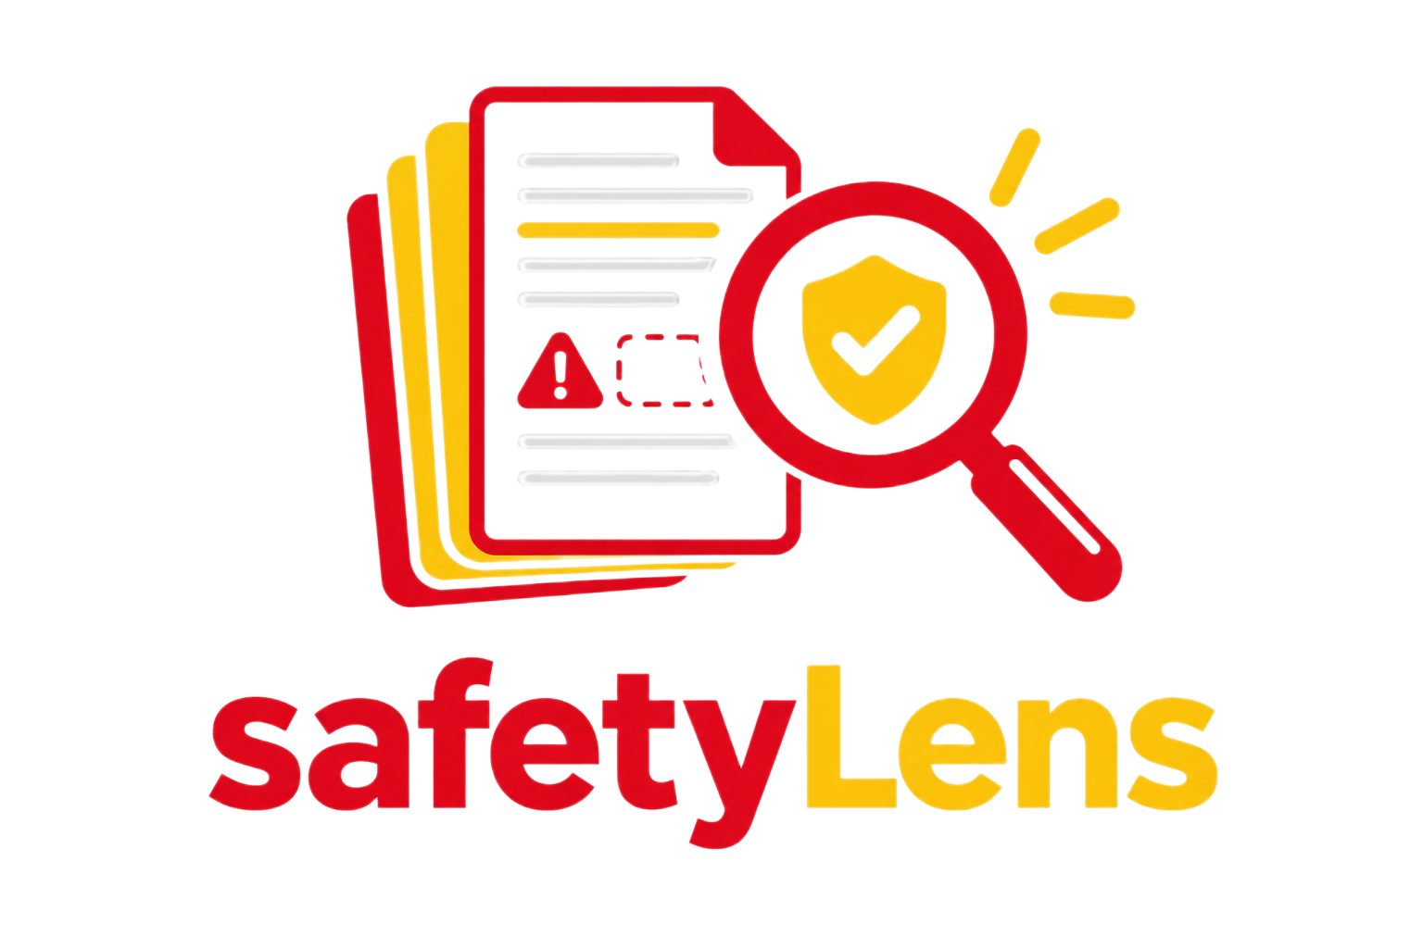
WHY NOW?
Fewer Skids, Broader Remit, Faster MOC Cadence
Lab consolidation
Fewer capability units in service, each carrying a broader remit than before.
Capability-based model
The same skid now serves ad hoc requests across very different chemistries, not one fixed process. Every new chemistry or envelope change triggers its own MOC cycle.
Review bottleneck
Manual hazard-basis prep can't keep pace with an ad hoc, high-frequency request cadence.
Frequent MOCs
The result: safety review volume and frequency are rising faster than headcount can absorb them — the same shared capability now needs an SafetyLens basis prepared far more often than the old.

Slide 2




What It Is ?
The tool drafts the basis; it never accepts the risk.
Why the Draft Can Be Trusted ?
It has no approval authority
Four independent analytical passes run on the same evidence. Conflicts between them are shown to the workshop, never quietly averaged away.
Evidenced, Inferred, or Gap — shown explicitly, never blended into one confident narrative tone.
From user inputs and connected safety documents, generates an evidence-based hazard-identification draft. It does not perform HAZOP, LOPA, safeguard/ESD assessment, or approve operations.
Disagreement is preserved
Every finding is tiered
Screening agent, not a decision-maker
safetyLens

Slide 3
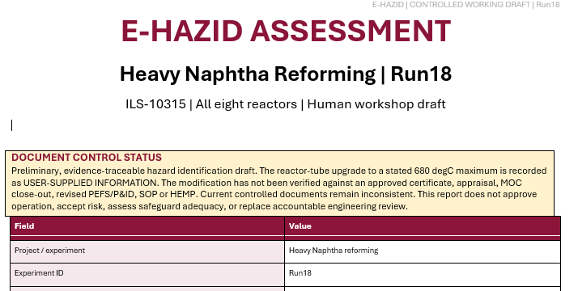
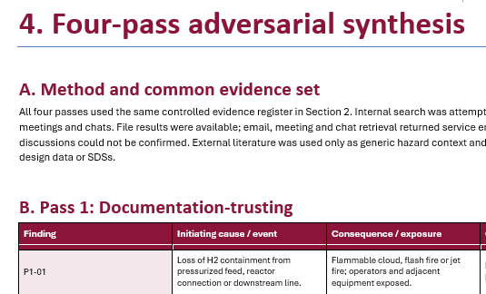
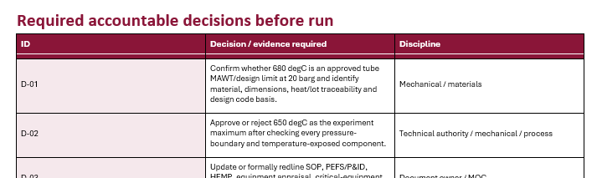
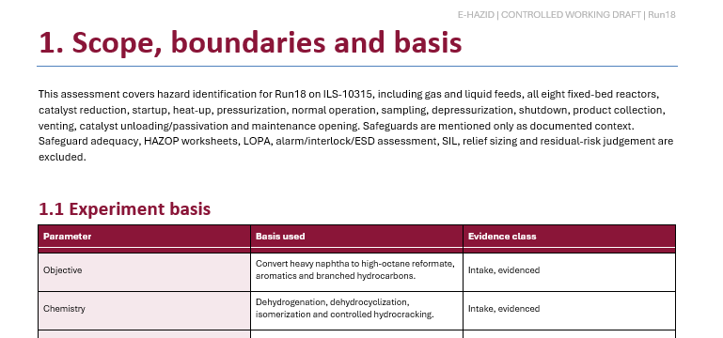
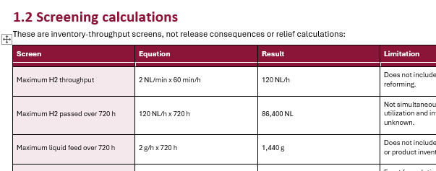
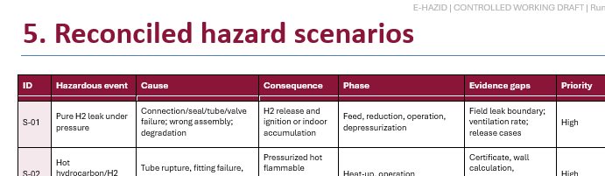
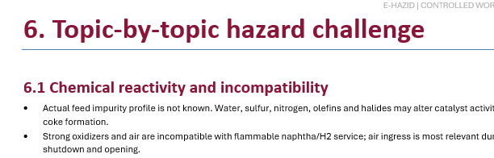
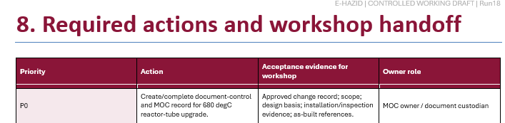
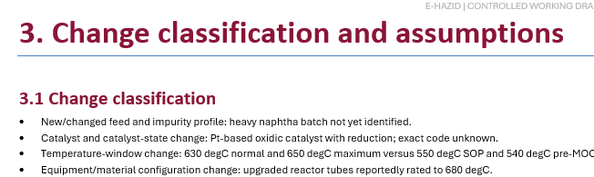
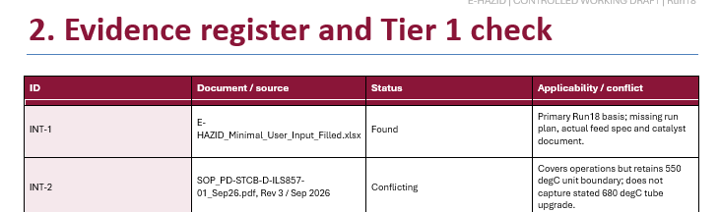
Moment of truth
safetyLens

Slide 4

Value Creation
The operating reality this tool is built for — not a hypothetical efficiency case.
The Real Shift
Don't let this get pattern-matched to “AI-powered HAZOP” and judged against a 40-year-old methodology it never tried to be:
It replaces the week spent reading old SOPs before the workshop starts — not the workshop, and not the judgment call.
Catches document drift before the field does
Applies literature-grounded checks consistently
Builds a compounding evidence base
Narrow, defensible scope
It compresses the pre-read, so that argument now starts from a cited synthesis, not memory
safetyLens

